Slide 1

Kubernetes
Lecture-1
www.corvit.com

Slide 2
Topics
What is Kubernetes?
What does Kubernetes do?
K8s Architecture Master Components
Node Components
Additional Services
Networking
K8s Solutions available in Market
Create AKS Cluster
Setting up Azure CLI and Kubectl on Local Machine
Deploy Sample App and Test
www.corvit.com

Slide 3
What is Kubernetes?
Kubernetes or K8s was a project spun out of Google as a open source next-gen container scheduler designed with the lessons learned from developing and managing Borg and Omega.
Kubernetes was designed from the ground-up as a loosely coupled collection of components centered around deploying, maintaining, and scaling applications.
www.corvit.com

Slide 4
What Does Kubernetes do?
Kubernetes is the linux kernel of distributed systems.
It abstracts away the underlying hardware of the nodes and provides a uniform interface for applications to be both deployed and consume the shared pool of resources.
www.corvit.com

Slide 5
Architecture Overview
Masters - Acts as the primary control plane for Kubernetes. Masters are responsible at a minimum for running the API Server, scheduler, and cluster controller. They commonly also manage storing cluster state, cloud-provider specific components and other cluster essential services.
Nodes - Are the ‘workers’ of a Kubernetes cluster. They run a minimal agent that manages the node itself, and are tasked with executing workloads as designated by the master.
www.corvit.com

Slide 6
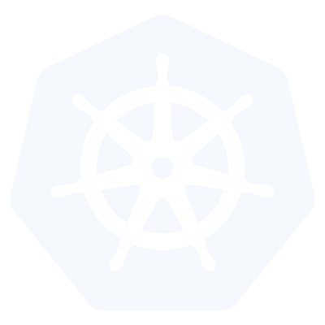
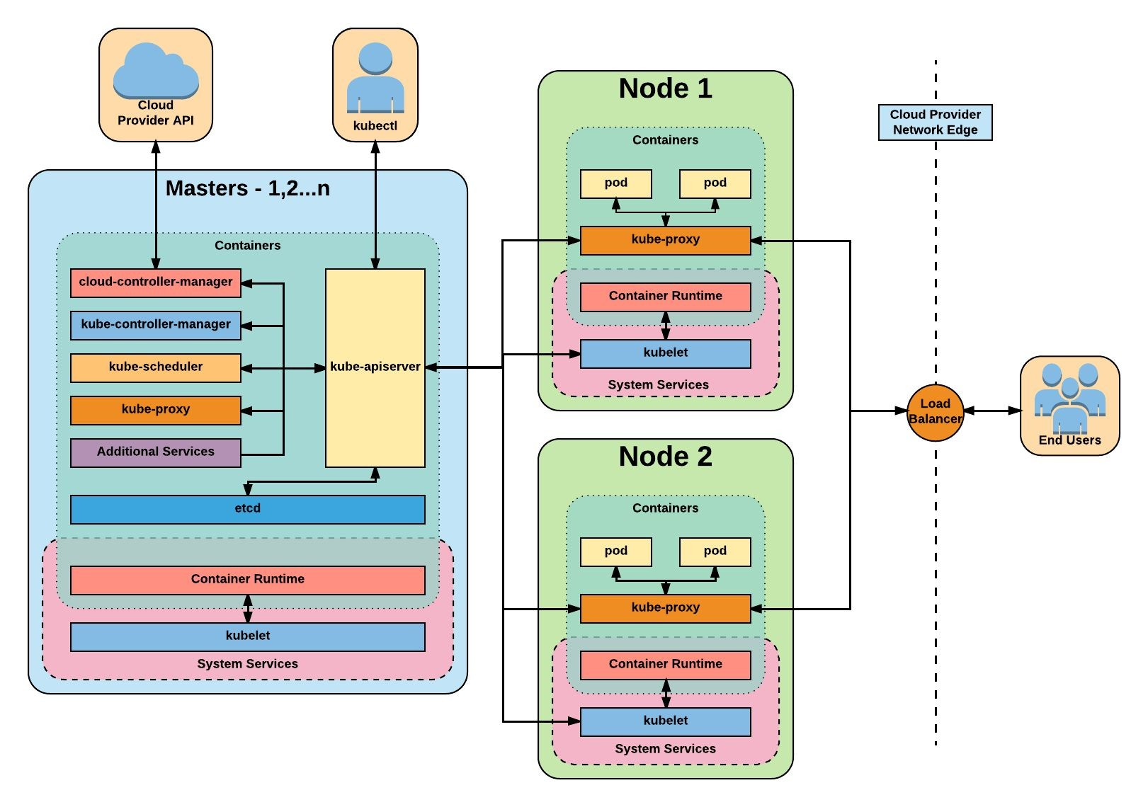
Architecture Overview
www.corvit.com

Slide 7
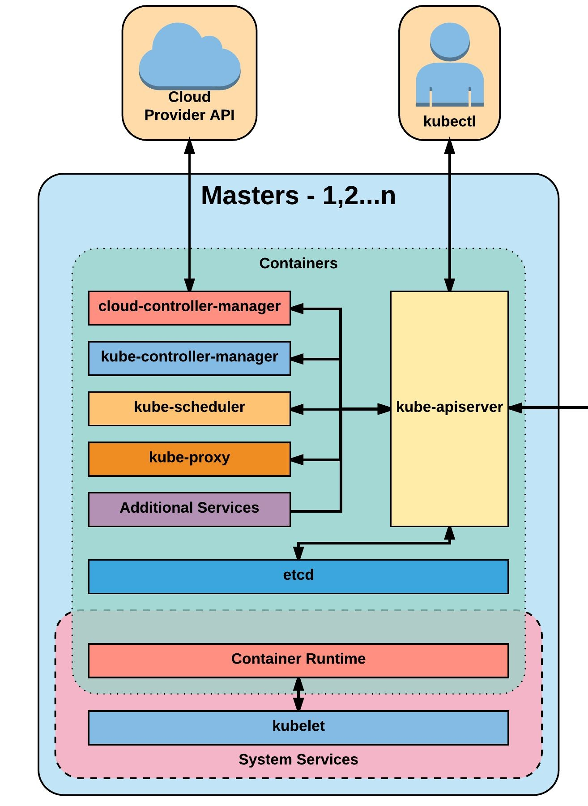
Master Components
Kube-apiserver
Etcd
Kube-controller-manager
Cloud-controller-manager
Kube-scheduler
www.corvit.com

Slide 8
kube-apiserver
The apiserver provides a forward facing REST interface into the kubernetes control plane and datastore. All clients, including nodes, users and other applications interact with kubernetes strictly through the API Server.
It is the true core of Kubernetes acting as the gatekeeper to the cluster by handling authentication and authorization, request validation, mutation, and admission control in addition to being the front-end to the backing datastore.
www.corvit.com

Slide 9
etcd
Etcd acts as the cluster datastore; providing a strong, consistent and highly available key-value store used for persisting cluster state.
www.corvit.com

Slide 10
Kube-Controller-Manager
The controller-manager is the primary daemon that manages all core component control loops. It monitors the cluster state via the apiserver and steers the cluster towards the desired state.
List of core controllers:
https://github.com/kubernetes/kubernetes/blob/master/cmd/kube-controller-manager/app/controllermanager.go#L332
www.corvit.com

Slide 11
Cloud-Controller-Manager
The cloud-controller-manager is a daemon that provides cloud-provider specific knowledge and integration capability into the core control loop of Kubernetes. The controllers include Node, Route, Service, and add an additional controller to handle PersistentVolumeLabels .
www.corvit.com

Slide 12
Kube-Scheduler
Kube-scheduler is a verbose policy-rich engine that evaluates workload requirements and attempts to place it on a matching resource. These requirements can include such things as general hardware reqs, affinity, anti-affinity, and other custom resource requirements.
www.corvit.com

Slide 13
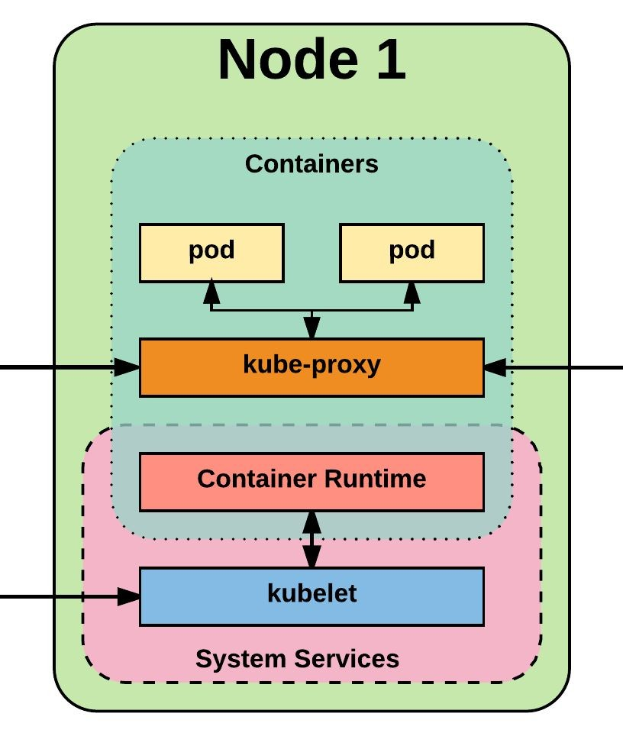
Node Components
Kubelet
Kube-proxy
Container runtime engine
www.corvit.com

Slide 14
kubelet
Acts as the node agent responsible for managing pod lifecycle on its host. Kubelet understands YAML container manifests that it can read from several sources:
File path
HTTP Endpoint
Etcd watch acting on any changes
HTTP Server mode accepting container manifests over a simple API.
www.corvit.com

Slide 15
kube-proxy
Manages the network rules on each node and performs connection forwarding or load balancing for Kubernetes cluster services.
Available Proxy Modes:
Userspace
iptables
ipvs (alpha in 1.8)
www.corvit.com

Slide 16
Container Runtime
With respect to Kubernetes, A container runtime is a CRI (Container Runtime Interface) compatible application that executes and manages containers.
Containerd (docker)
Cri-o
Rkt
Kata (formerly clear and hyper)
Virtlet (VM CRI compatible runtime)
www.corvit.com

Slide 17
Additional Services
Kube-dns - Provides cluster wide DNS Services. Services are resolvable to
<service>.<namespace>.svc.cluster.local.
Heapster - Metrics Collector for kubernetes cluster, used by some resources such as the Horizontal Pod Autoscaler. (required for kubedashboard metrics)
Kube-dashboard - A general purpose web based UI for kubernetes.
www.corvit.com

Slide 18
Networking - Fundamental Rules
All Pods can communicate with all other Pods without NAT
All nodes can communicate with all Pods (and vice-versa) without NAT.
The IP that a Pod sees itself as is the same IP that others see it as.
www.corvit.com

Slide 19
Networking - Fundamentals Applied
Containers in a pod exist within the same network namespace and share an IP; allowing for intrapod communication over localhost.
Pods are given a cluster unique IP for the duration of its lifecycle, but the pods themselves are fundamentally ephemeral.
Services are given a persistent cluster unique IP that spans the Pods lifecycle.
External Connectivity is generally handed by an integrated cloud provider or other external entity (load balancer)
www.corvit.com

Slide 20
Networking - CNI
Networking within Kubernetes is plumbed via the Container Network Interface (CNI), an interface between a container runtime and a network implementation plugin.
Compatible CNI Network Plugins:
Calico
Cillium
Contiv
Contrail
Flannel
GCE
kube-router
Multus
OpenVSwitch
OVN
Romana
Weave
www.corvit.com

Slide 21
Kubernetes Solutions
There are several Kubernetes solutions available, each with its own set of features and capabilities. Here are some of the most popular options:
Kubernetes as a Service (KaaS): This is a cloud-based solution that allows you to deploy and manage Kubernetes clusters in a managed environment, without the need to manage the underlying infrastructure. Some examples of KaaS solutions include Amazon Elastic Kubernetes Service (EKS), Google Kubernetes Engine (GKE), and Microsoft Azure Kubernetes Service (AKS).
Managed Kubernetes: This is a solution that provides a managed Kubernetes service on top of a cloud platform, such as AWS, Google Cloud, or Microsoft Azure. Examples of Managed Kubernetes solutions include Amazon EKS, Google Kubernetes Engine (GKE), and Azure Kubernetes Service (AKS).
Kubernetes Distribution: This is a pre-packaged version of Kubernetes that includes additional tools, add-ons, and features. Some popular Kubernetes distributions include Red Hat OpenShift, Rancher, and VMware Tanzu Kubernetes Grid (TKG).
www.corvit.com

Slide 22
Kubernetes Solutions
DIY Kubernetes: This is a solution that involves manually setting up and managing a Kubernetes cluster on your own infrastructure, whether it be on-premises or in a public cloud environment. This approach gives you more control over your Kubernetes environment but requires more technical expertise.
Edge Kubernetes: This is a solution that allows you to run Kubernetes clusters on edge devices and in remote locations, such as factories, retail stores, and warehouses. Examples of edge Kubernetes solutions include K3s and OpenYurt.
OKD and Minikube are single node options available.
Minikube is a lightweight and easy-to-use tool that enables you to run Kubernetes locally on your own computer. It is designed to allow developers and operators to quickly spin up a single-node Kubernetes cluster on their laptop or desktop, for the purpose of testing, developing, and experimenting with Kubernetes features and applications.
www.corvit.com

Slide 23
Create AKS Cluster
www.corvit.com

Slide 24
Setting up Azure CLI and Kubectl on Local Machine
For Linux:
1- Add the Azure CLI repository to your system:
curl -sL https://aka.ms/InstallAzureCLIDeb | sudo bash
2- Install the Azure CLI:
sudo apt-get install azure-cli
3- Verify the installation:
az –version
4- Download the latest version of kubectl:
curl -LO https://dl.k8s.io/release/$(curl -L -s https://dl.k8s.io/release/stable.txt)/bin/linux/amd64/kubectl
5- Make kubectl executable:
chmod +x ./kubectl
6- Move kubectl to your PATH:
sudo mv ./kubectl /usr/local/bin/kubectl
7- Verify the installation:
kubectl version –client
8- Connect Azure CLI with Kubernetes:
az login
9- Get the Kubernetes cluster credentials:
az aks get-credentials --resource-group <resource_group_name> --name <cluster_name>
10- Verify the connection:
kubectl get nodes
www.corvit.com

Slide 25
Setting up Azure CLI and Kubectl on Local Machine
For Windows:
1- Download and install Azure CLI:
Go to https://docs.microsoft.com/en-us/cli/azure/install-azure-cli-windows?tabs=azure-cli
2- Verify Azure CLI installation:
Type "az" and press Enter. If Azure CLI is installed correctly, it will display the available commands and options.
3- Download and install kubectl:
Go to https://kubernetes.io/docs/tasks/tools/install-kubectl-windows/#install-kubectl-binary-with-curl-on-windows
Follow the instructions under "Install kubectl Binary with curl" to download and install kubectl
4- Download the latest version of kubectl:
curl -LO https://dl.k8s.io/release/$(curl -L -s https://dl.k8s.io/release/stable.txt)/bin/linux/amd64/kubectl
5- Verify kubectl installation:
Open a command prompt window.
Type "kubectl version" and press Enter. If kubectl is installed correctly, it will display the client and server versions.
6- Connect Azure CLI to your Azure account:
az login
7- Connect kubectl to your Kubernetes cluster:
az aks get-credentials --resource-group <resource_group_name> --name <cluster_name>
8- Verify the connection:
kubectl get nodes
www.corvit.com

Slide 26
Deploy Sample App and Test
www.corvit.com

